Slide 1

Discrete Simulation of the motion of underwater Soft Robotic Gripper
Ben Forbes
Mechanical Engineering
Premkumar Sivakumar
Mechanical Engineering

Slide 2
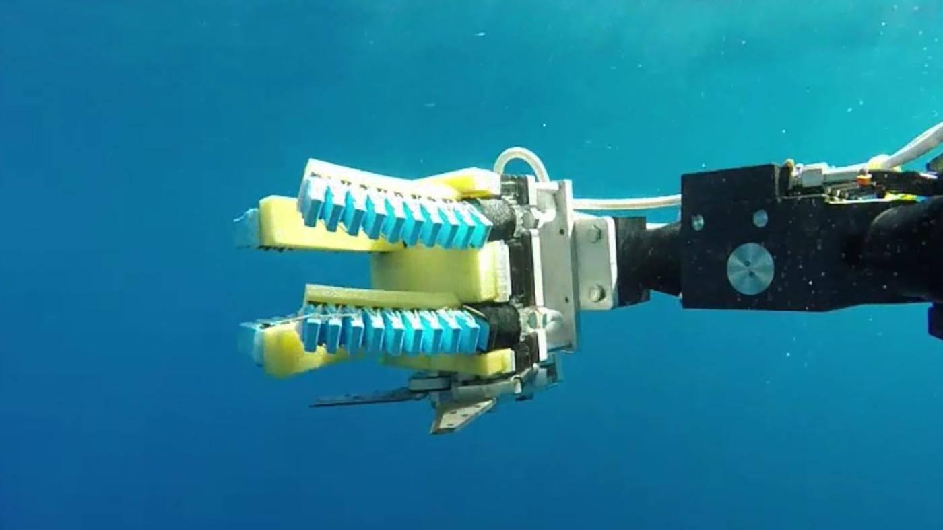
Background
Traditional robotic grippers:
Lack adaptability
Damage fragile objects
Soft robotic grippers:
Pneumatics – pressure differential with localized bending or stretching
Soft plastic or elastomer that contain intrinsic elastic properties
EOM from geometry and pressure differential, then FEA
Notes:
Traditional robotic grippers consist of rigid links and joints that can be actuated by motors or tendons. While this class of grippers excel in known environments, like industrial settings, they lack much of the adaptability needed to interact with all objects, namely odd shaped or fragile objects. In these cases, contact between a hard gripper, at high forces, can damage an object or move it in unpredictable ways. Soft robotics has emerged as the leading candidate to solve these problems, by creating a class of robotic grippers that provides delicate grasps and can easily conform to a given object.
The actuation method for soft robotic grippers contrasts typical robotic end effectors. Pneumatics are commonly used to provide a pressure differential inside of a hollow gripper finger, with the localized bending or stretching being dependent on the geometry and material properties of the finger. For this reason, many soft robotic fingers are made out of soft plastic or elastomer that contain intrinsic elastic properties, i.e. if they are bent, they apply some sort of restoring force. Many researchers focus on deriving the equations of motion from the geometry and pressure differential for each node in the finger, and follow up by simulating their designs in finite element analysis.
These grippers, due to their restoring elastic properties, are considered underactuated, as motion is due to deliberate actuation.
The project aims at a different approach to modeling soft robotic grippers: discrete analysis. This approach boils down the material properties to a single node and edge based beam, but provides advantages in modeling external forces.

Slide 3
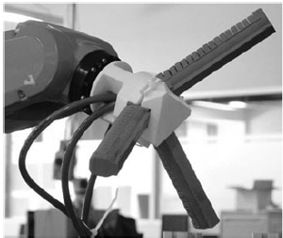
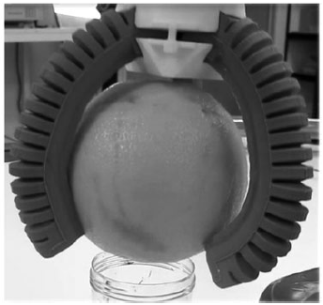
Objective
This project aims to simulate discrete motion of multi-finger soft robotic gripper especially with programmable variable stiffness for an underwater environment

Slide 4
Project Inspiration
Adopted the gripper from Alici et al. [2]
Three fingers attached to the gripper housing
Each finger is a chamber-based pneumatic actuator
Fingers made of elastomeric silicone designed with ridges, embedded with a bistable metal layer
The bistable layer is inextensible, turning any extension force into bending moment – no stretching
Motion of the gripper finger is confined to a plane – no twisting

Slide 5
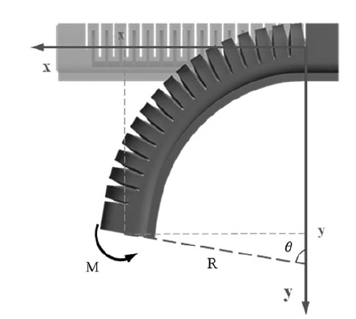
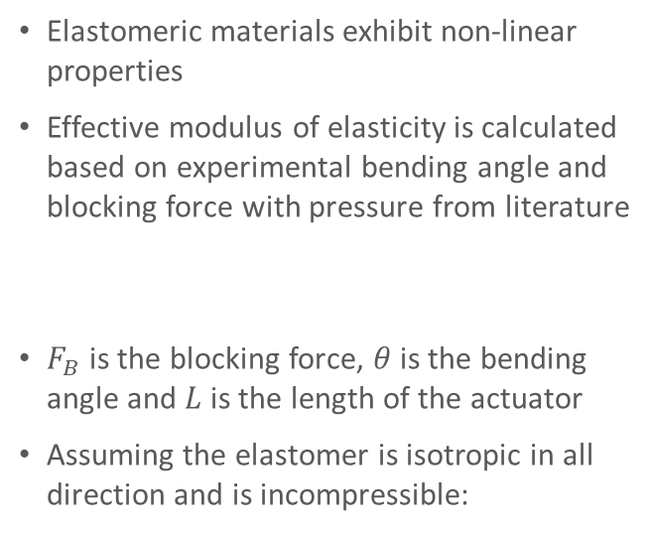


Material Properties
Elastomeric materials exhibit non-linear properties
Effective modulus of elasticity is calculated based on experimental bending angle and blocking force with pressure from literature
$F_{B}$ is the blocking force, $θ$ is the bending angle and $L$ is the length of the actuator
Assuming the elastomer is isotropic in all direction and is incompressible:
$$EI=\frac{L^{2}F_{B}}{θ}$$
$$G=\frac{E}{3}$$

Slide 6


Model Overview
 | Physical Gripper | Our Discrete Model
Three fingers
Bistable metal layer
Variable Elastic Modulus
Bending
Stretching
Twisting
Material sensitivity
Actuation
Unsymmetrical cross-section

Slide 7
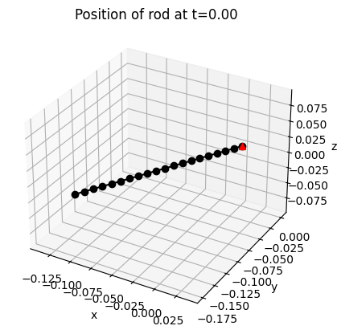
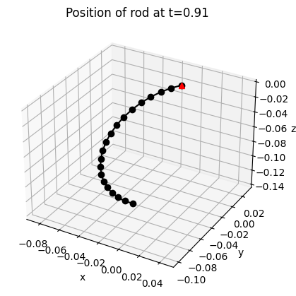
Methods
Gripper modelled as 20 nodes connected by 19 edges, with first two nodes fixed:
Analogous to discrete elastic cantilever beam in viscous medium
Implicit treatment of the elasticity
Forces:
Elastic force – from local elastic bending, stretching and twisting energy at each discrete node
Inertial force – the mass of the actuator is distributed as point masses at different nodes
External force – gravitational force and viscous force from water

Slide 8
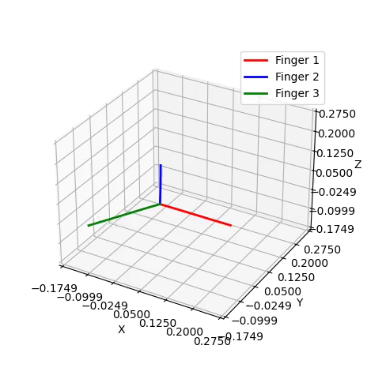
Model Setup
Each actuator finger:
Is 20 cm long with 2 cm cross-sectional radius
Uses a constant elastic stiffness
Is initially in a straight rod configuration
Has material properties of Elastosil MA 4601 & soft translucent hyper-elastic silicone in water
Has constant Elastic modulus calculated based on experimental bending angle and blocking force data with pressure from literature

Slide 9
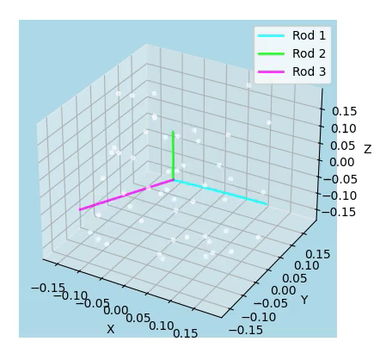
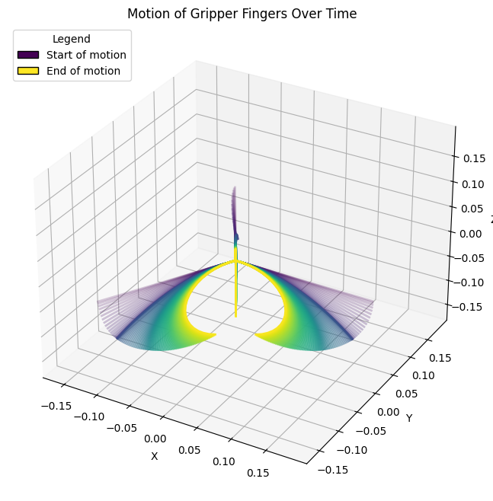
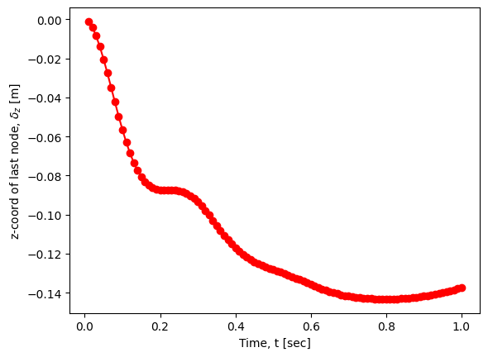
Gripper Motion Simulation
Total simulation time of 1 sec with 0.01 sec time step size
Smooth Actuation – varying natural curvature with time $(\overline{κ}=−0.15 ∗ctime)$
Actuation (underwater version)
Timeline of gripper actuation
Z-coordinate of finger

Slide 10
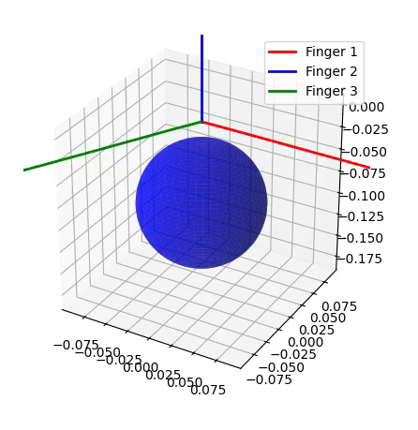
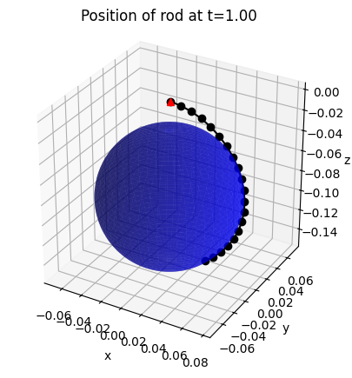
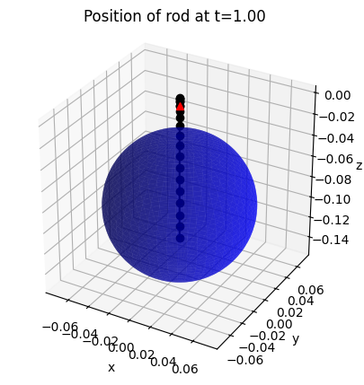
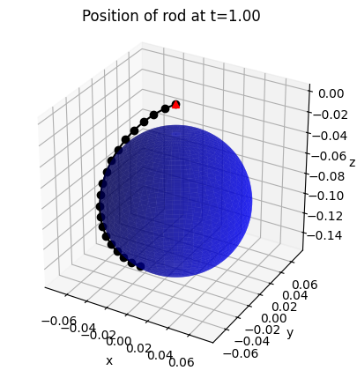
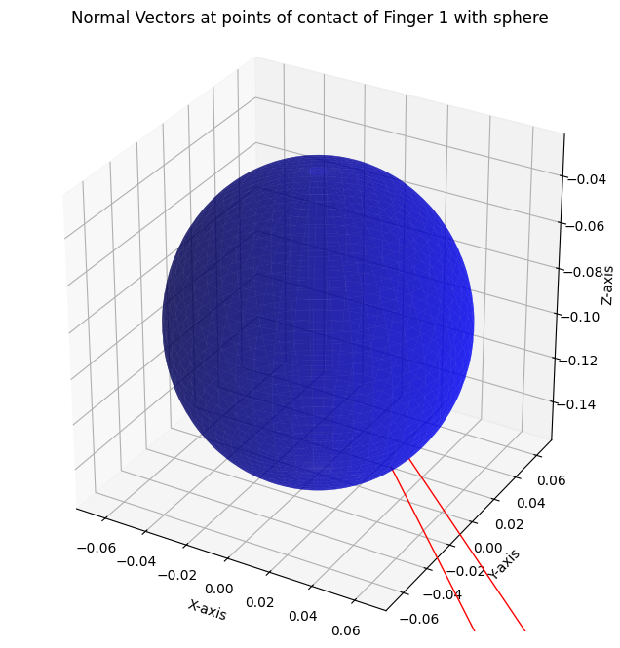
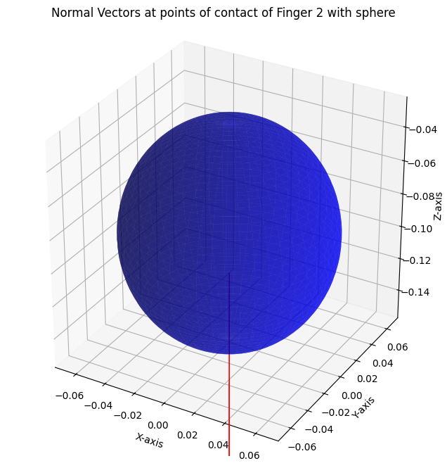
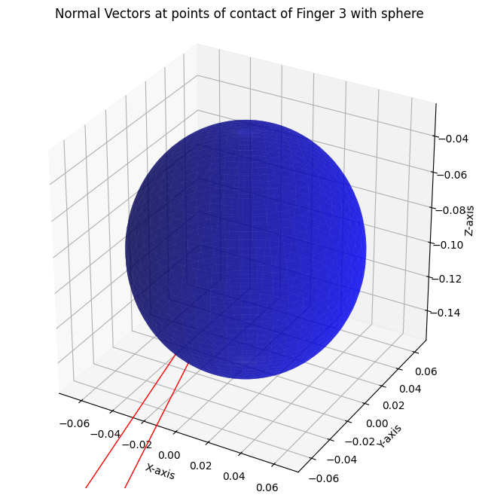
Contact Detection (Predictor-Corrector)
Checked if each node crossed the object surface
Fixed the node to the projected point on the surface in the direction of the normal

Slide 11
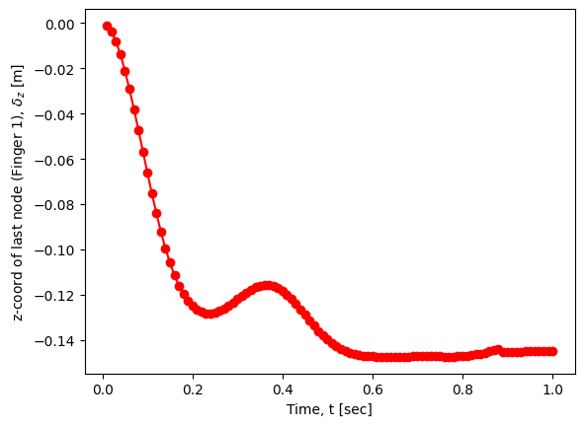
Material Sensitivity
Elastosil MA 4601
Soft Translucent Silicone
Total reaction force in the contact zone for one finger is 33.86 N
Total reaction force in the contact zone for one finger is 21.23 N

Slide 12
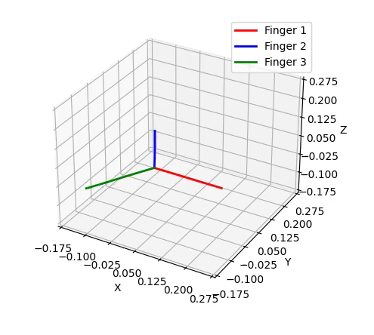
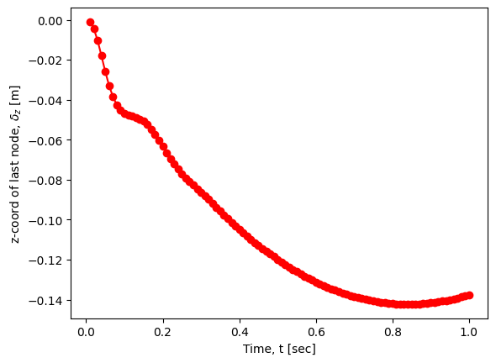

Variable Stiffness
Fixed Stiffness
Variable Stiffness
Linear decrease in cross-sectional area
$$r0=0.001∗\left(nv −c\right)$$
Variable Stiffness Actuation
Decrease in bending stiffness

Slide 13
References
Huang, W., Huang, X., Majidi, C. et al. Dynamic simulation of articulated soft robots. Nat Commun 11, 2233 (2020). https://doi.org/10.1038/s41467-020-15651-9
Alici et al. Modeling and experimental evaluation of bending behavior of soft pneumatic actuators made of discrete actuation chambers. Soft Robotics Vol. 5, No. 1 (2018). https://doi.org/10.1089/soro.2016.0052
Hao Y, Wang T, Ren Z, et al. Modeling and experiments of a soft robotic gripper in amphibious environments. International Journal of Advanced Robotic Systems. 2017;14(3). doi:10.1177/1729881417707148
Yin Haibin, Kong Cheng, Li Junfeng, Yang Guilin. Modeling of grasping force for a soft robotic gripper with variable stiffness. Mechanism and Machine Theory, Volume 128, 2018, Pages 254-274, ISSN 0094-114X. https://doi.org/10.1016/j.mechmachtheory.2018.05.005.
Zhou, Y., Headings, L. M., and Dapino, M. J. (November 15, 2021). "Modeling of Soft Robotic Grippers Integrated With Fluidic Prestressed Composite Actuators." ASME. J. Mechanisms Robotics. June 2022; 14(3): 031001. https://doi.org/10.1115/1.4052699
Y. Zhou, L. M. Headings and M. J. Dapino, "Modeling of Fluidic Prestressed Composite Actuators With Application to Soft Robotic Grippers," in IEEE Transactions on Robotics, vol. 38, no. 4, pp. 2166-2178, Aug. 2022, doi: 10.1109/TRO.2021.3139770.
J. Shintake, V. Cacucciolo, D. Floreano, H. Shea, Adv. Mater. 2018, 30, 1707035. https://doi.org/10.1002/adma.201707035
X. 1 Tang et al., “A Review of Soft Actuator Motion: Actuation, Design, Manufacturing and Applications,” p.331, 2022, doi: 10.3390/act11110331.
K. M. de Payrebrune and O. M. O’Reilly, “On constitutive relations for a rod-based model of a pneu-net bending actuator,” Extreme Mech. Lett., vol. 8, pp. 38–46, Sep. 2016, doi: 10.1016/j.eml.2016.02.007
K. M. de Payrebrune and O. M. O’Reilly, “On the development of rod-based models for pneumatically actuated soft robot arms: A five-parameter constitutive relation,” Int. J. Solids Struct., vol. 120, pp. 226–235, Aug. 2017, doi: 10.1016/j.ijsolstr.2017.05.003.
https://newatlas.com/underwater-exploration-soft-robotic-hands/41433/

Slide 14
Thank you!

